Slide 1
Unit 1: Free Time
Lesson 1.1: Vocab & Reading
Pages 4 & 5

Slide 2
Lesson Outline
Warm-up
Vocabulary
Reading
Consolidation
Wrap-up

Slide 3
By the end of this lesson, students will be able to…
- learn and use vocabulary for leisure activities.
- practice reading for detail.

Slide 4
New words
1. chat
2. fishing
3. hang out
4. jogging
5. jewelry
6. handball
7. rock climbing
8. board games

Slide 5
WARM UP

Slide 6
Work in pairs.
Let’s talk: Look at the title of the unit and the picture. What do the girls like doing in their free time? What do you do in your free time? How often do you do it?

Slide 7
Pre-reading

Slide 9
Work in pairs. What can you see in each picture?

Slide 10
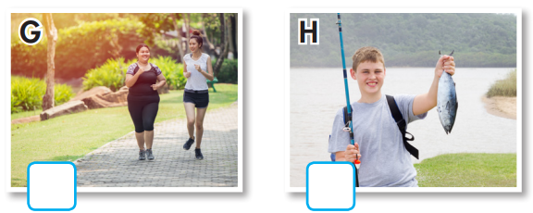
a. Number the pictures.
1. chat
2. fishing
3. hang out
4. jogging
5. jewelry
6. handball
7. rock climbing
8. board games
3
5
7
6
8
4
2

Slide 11
Listen and repeat. Click on each phrase to hear the sound.
chat (v) /tʃæt/ trò chuyện, tán gẫu
fishing (n) /ˈfɪʃɪŋ/ câu cá
hang out (v phr) /hæŋ aʊt/ gặp gỡ bạn bè, đi chơi
jogging (n) /ˈdʒɑːɡɪŋ/ (hoạt động) chạy bộ nhẹ
jewelry (n) /ˈdʒuːəlri/ đồ trang sức
handball (n) /ˈhændbɔːl/ (môn thể thao) bóng ném
rock climbing (n phr) /ˈrɑːk klaɪmɪŋ/ (môn thể thao) leo núi đá
board games (n phr) /ˈbɔːrd ɡeɪm/ trò chơi có bàn cờ
Notes:
GV click vào từng cụm nghe âm thanh

Slide 12
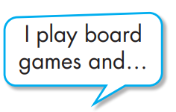
b. Write the new words into the table and add more words you know. Which activities do you do?
rock climbing
jewelry
jewelry
hang out
handball
jogging
chat online
fishing

Slide 14
Pre - reading
Pair work: Name some indoor activities you know.
Reading books
Cooking
Drawing
Playing chess
Playing board games
Surfing the internet
Watching TV
Playing computer games

Slide 15
Task a
Read the instruction and the answers quickly:
Underline the key words.
What are we going to do?
Read and circle the person who prefers indoor activities.
a. Read the passages. Circle the name of the person who prefers indoor activities.
Will Jess Peter

Slide 16
While-reading

Slide 17
While - reading
Scan the text. Underline the activities each person prefers doing. Choose the correct name.
My name's Will. I love playing sports and hanging out with my friends. We love playing handball and soccer together. I think they're really exciting. I don't really like extreme sports, like skateboarding or rock climbing. They're too scary for me. I prefer safer activities, like jogging or watching TV.

Slide 18
Hello. My name's Jess. I'm not a very active person. I like reading books, chatting with my friends online, and doing arts and crafts in my bedroom. My favorite thing to do is painting. It's so relaxing. I hate playing sports and jogging. I don't think they are very fun. I prefer playing board games at home.
Hi. I'm Peter. I love doing lots of different activities. I like playing tennis with friends and I love rock climbing. It's so much fun. I also like designing clothes and bags. I don't really enjoy playing board games though. I think they're boring. I prefer singing and dancing with my friends in my backyard.

Slide 19
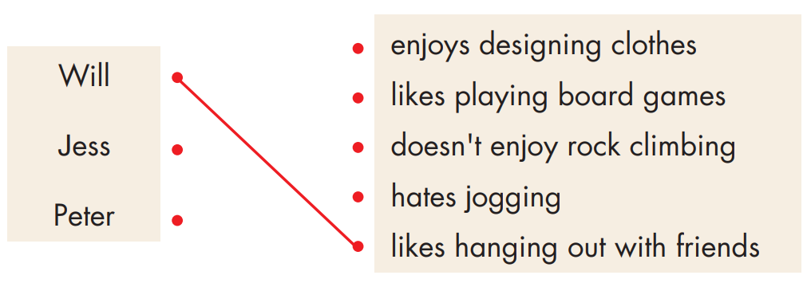
Task b
Pre-reading
Read the instruction and underline the key words.
What are we going to do?
Read and match the phrase and the person.
Read and draw lines to match the phrases and the person they describe.

Slide 20
While - reading
Scan the text. Underline the key words and match the names with the correct phrases.
My name's Will. I love playing sports and hanging out with my friends. We love playing handball and soccer together. I think they're really exciting. I don't really like extreme sports, like skateboarding or rock climbing. They're too scary for me. I prefer safer activities, like jogging or watching TV.

Slide 21
Hello. My name's Jess. I'm not a very active person. I like reading books, chatting with my friends online, and doing arts and crafts in my bedroom. My favorite thing to do is painting. It's so relaxing. I hate playing sports and jogging. I don't think they are very fun. I prefer playing board games at home.
Hi. I'm Peter. I love doing lots of different activities. I like playing tennis with friends and I love rock climbing. It's so much fun. I also like designing clothes and bags. I don't really enjoy playing board games though. I think they're boring. I prefer singing and dancing with my friends in my backyard.

Slide 22
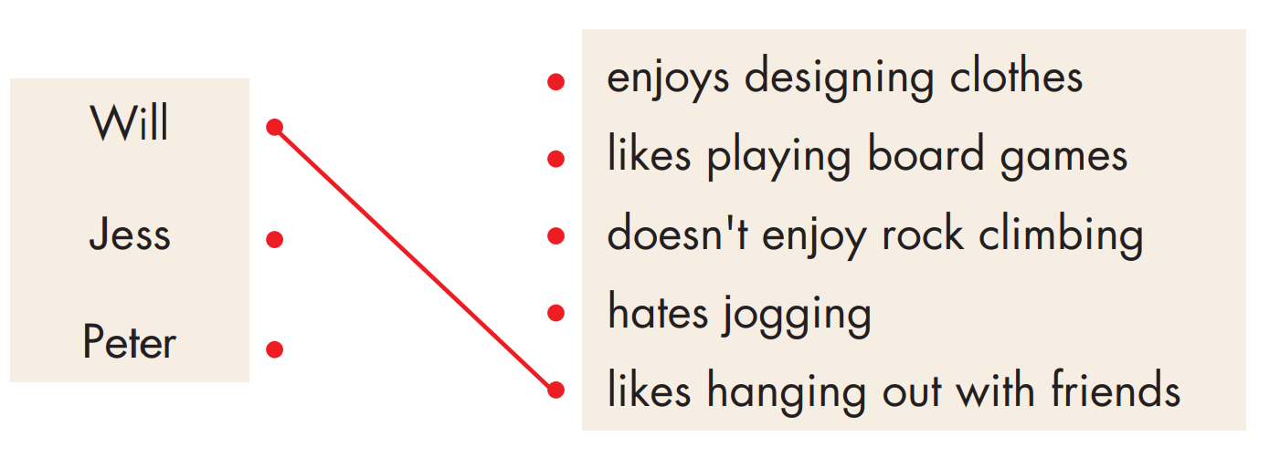
While-reading

Slide 23
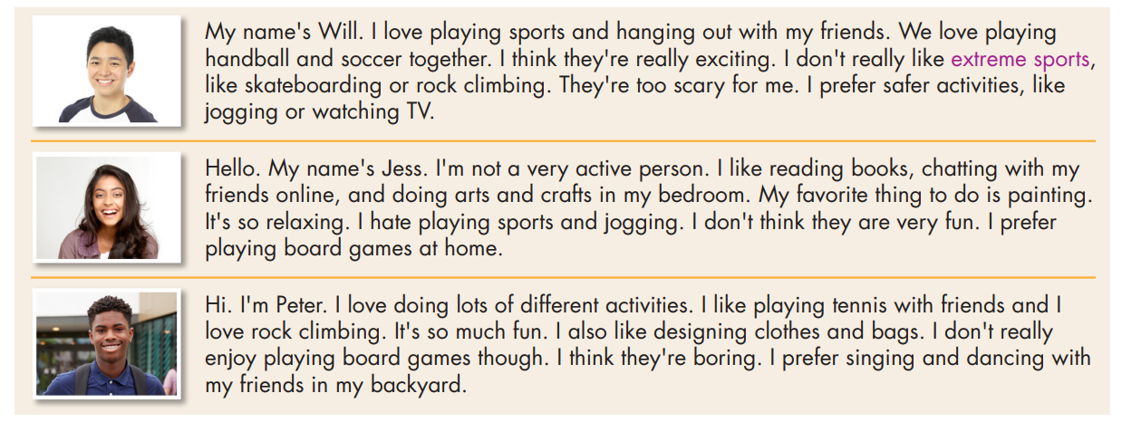
c. Listen and read.

Slide 24
Post-reading

Slide 25
Post - reading
Work in pairs
Which person are you most like? How are you similar? How are you different?
I'm most like Jess. I also like reading books, but I don't like playing board games.

Slide 26
CONSOLIDATION

Slide 27
Talk to your partner about what teenagers like doing in their free time.

Slide 28
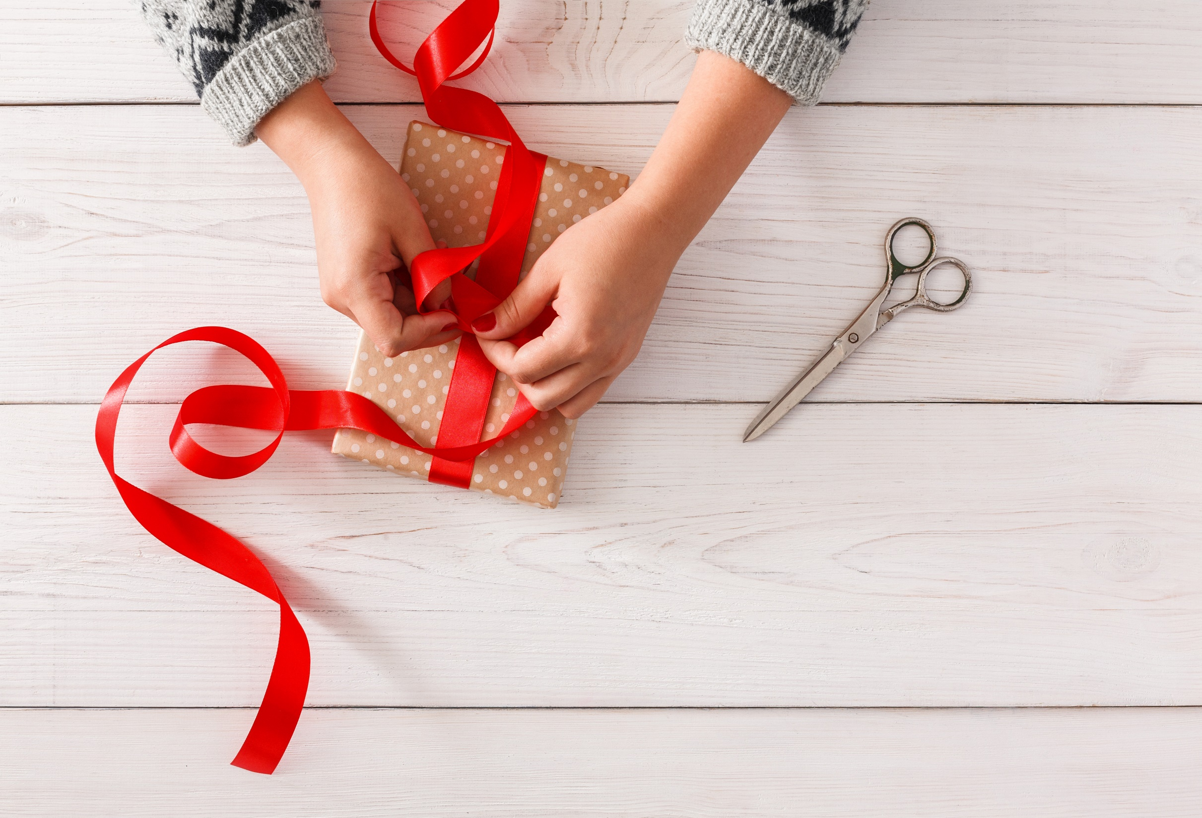
WRAP-UP

Slide 29
Today’s lesson
Vocabularies
1. chat
2. fishing
3. hang out
4. jogging
5. jewelry
6. handball
7. rock climbing
8. board games

Slide 30
Today’s lesson
Reading:
- Understanding instructions
Scanning for specific information
Speaking:
- Talking about hobbies

Slide 31
Homework
Learn by hearts vocab. and make sentences using them.
Do the vocab. and reading exercises on pages 2 & 3 WB.
Do the exercises in Tiếng Anh 8 i-Learn Smart World Notebook on pages 4 & 5.
Prepare the next lesson (pages 5 & 6 SB).
Play the consolidation games on www.eduhome.com.vn

Slide 32
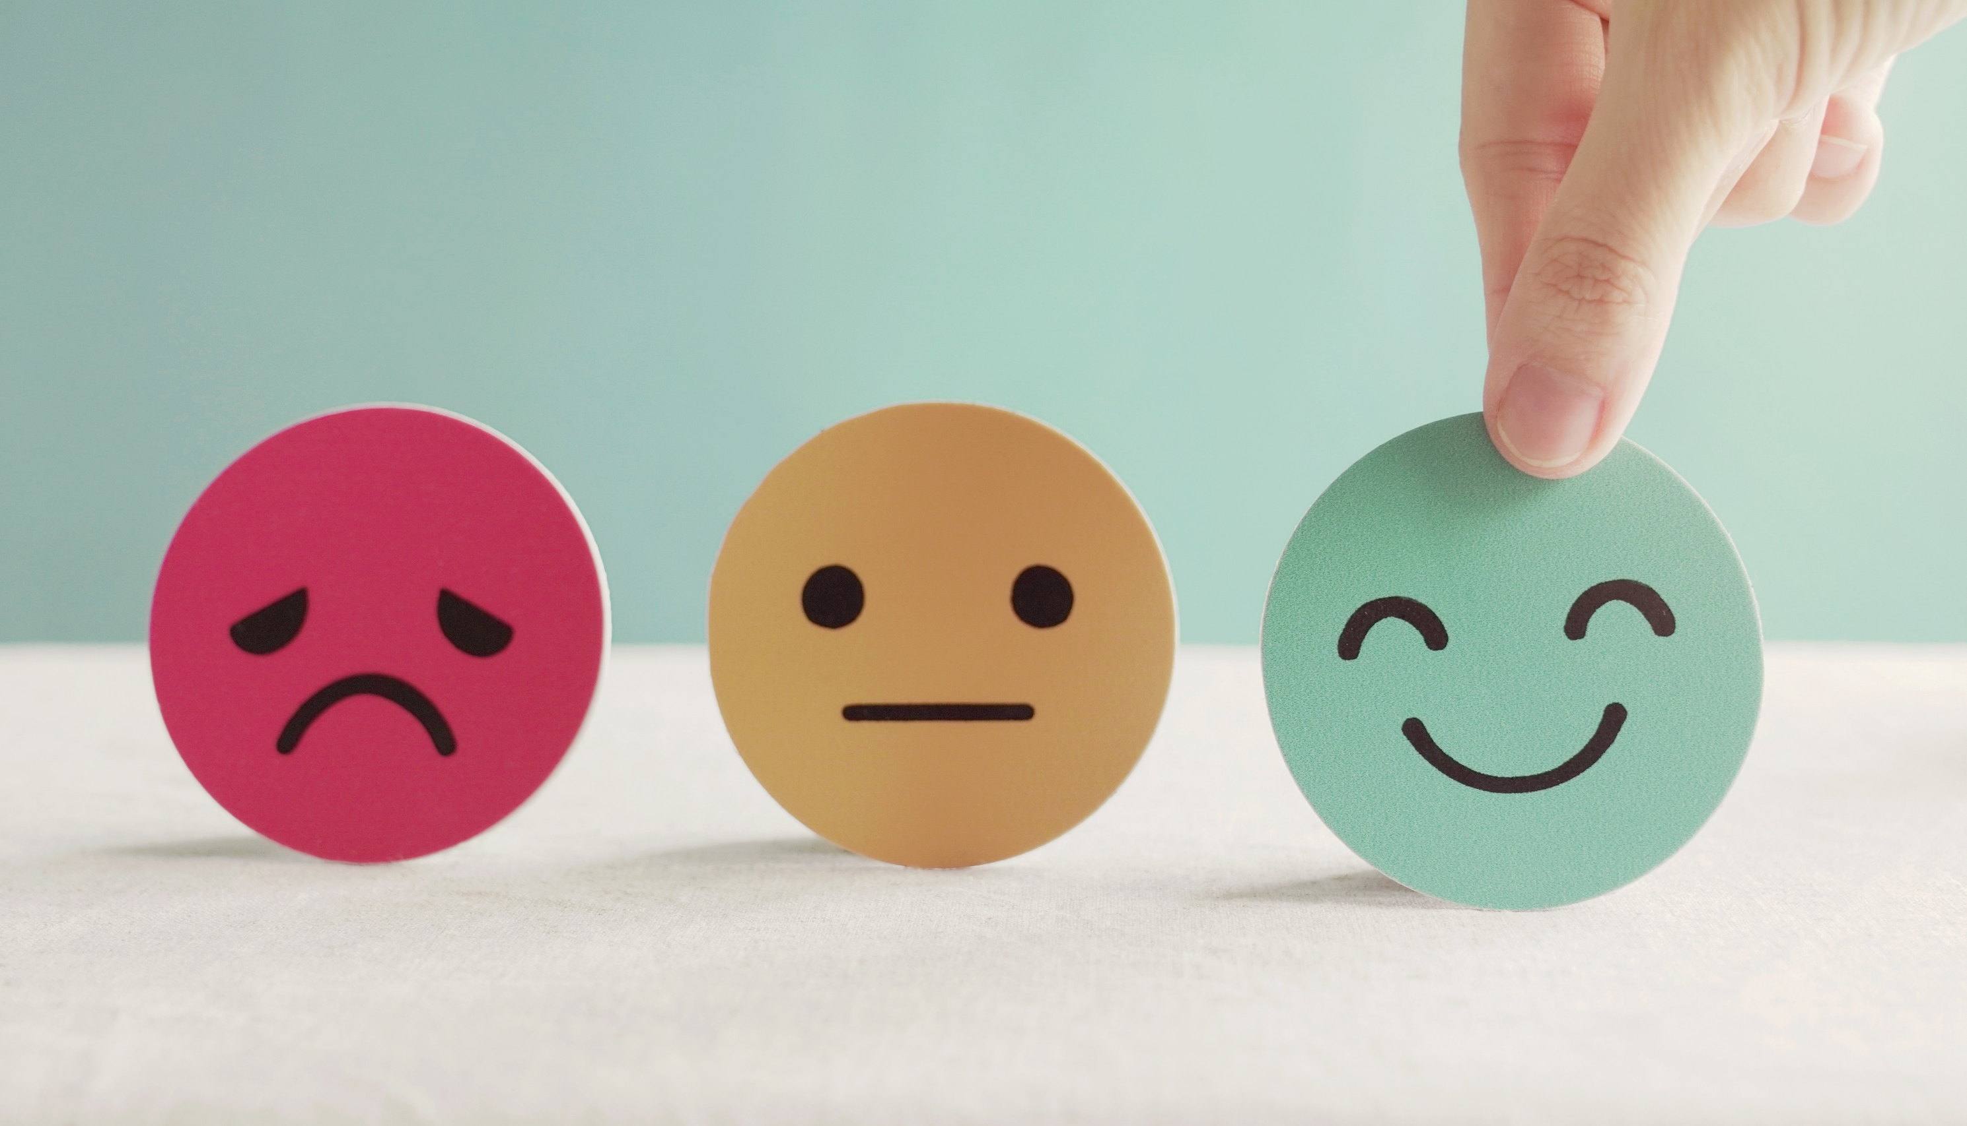
Lesson 3
Stay positive and have a nice day!

